Slide 1
NORTH SAVO
10.9.2024
North Savo Regional Council

Slide 2
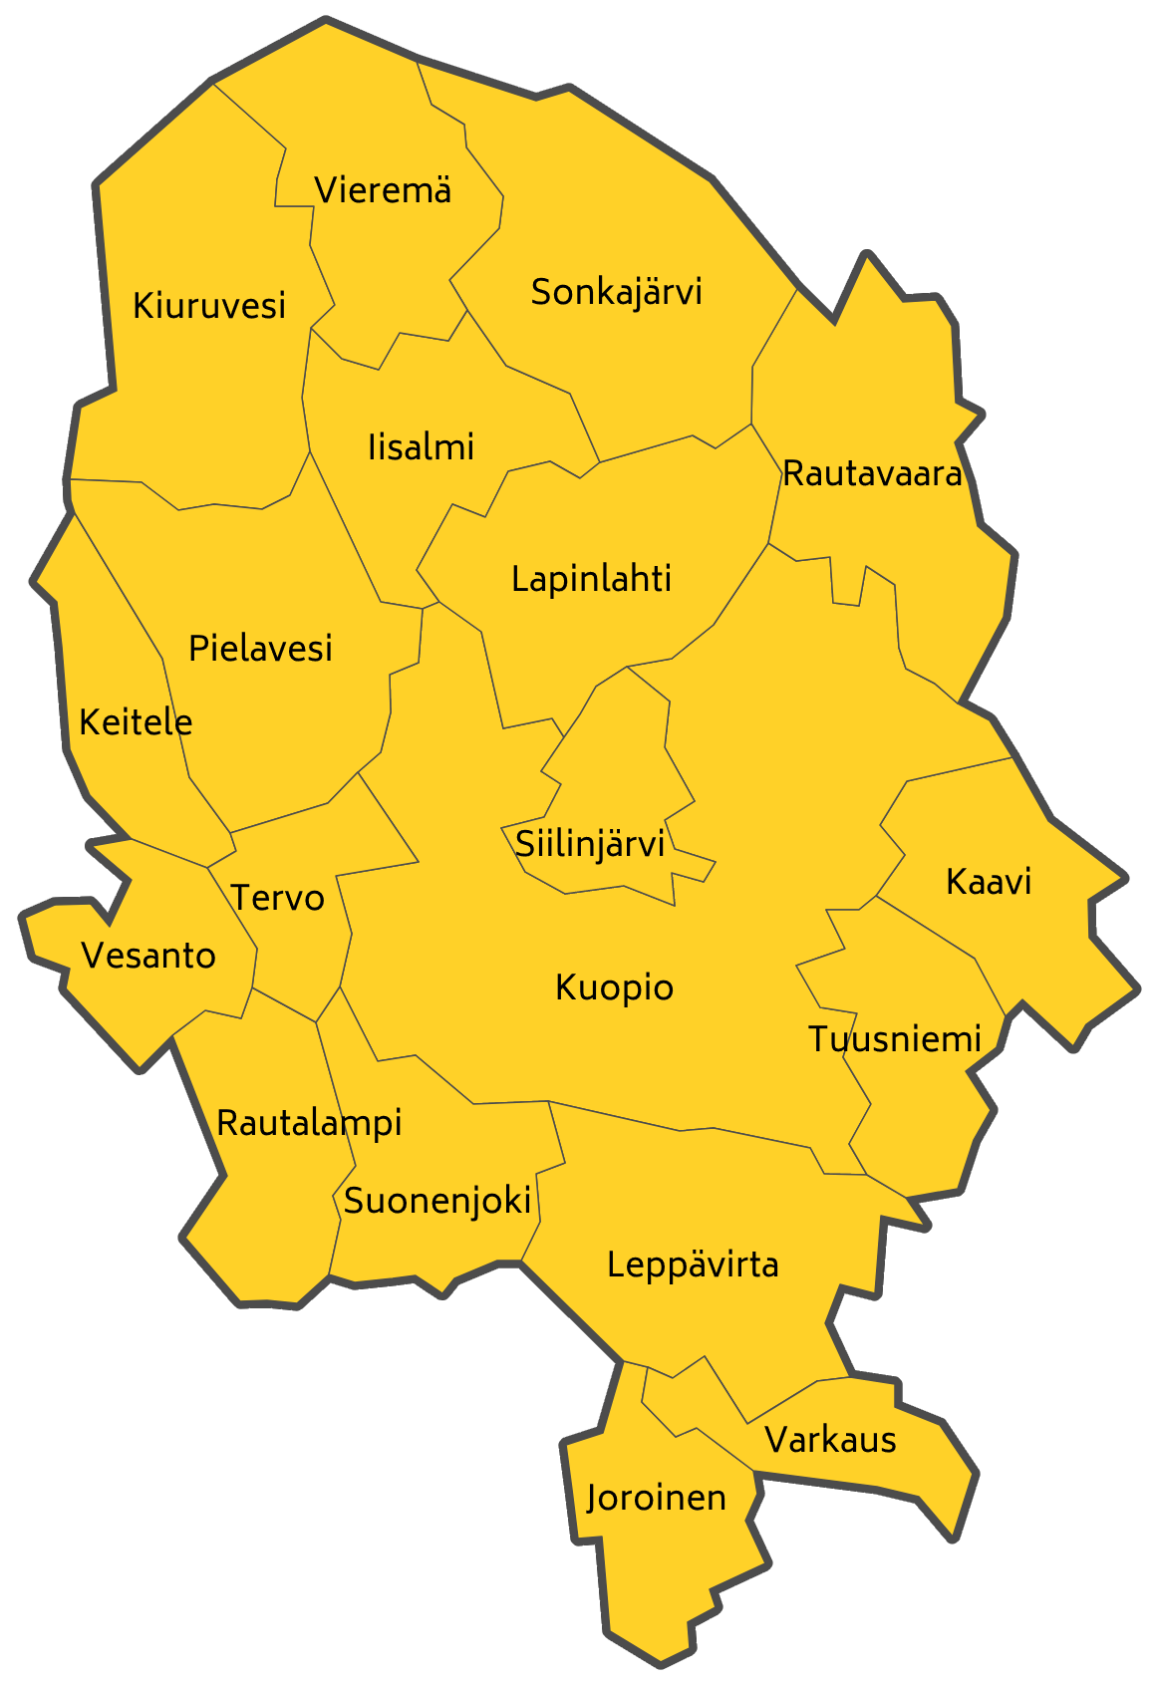
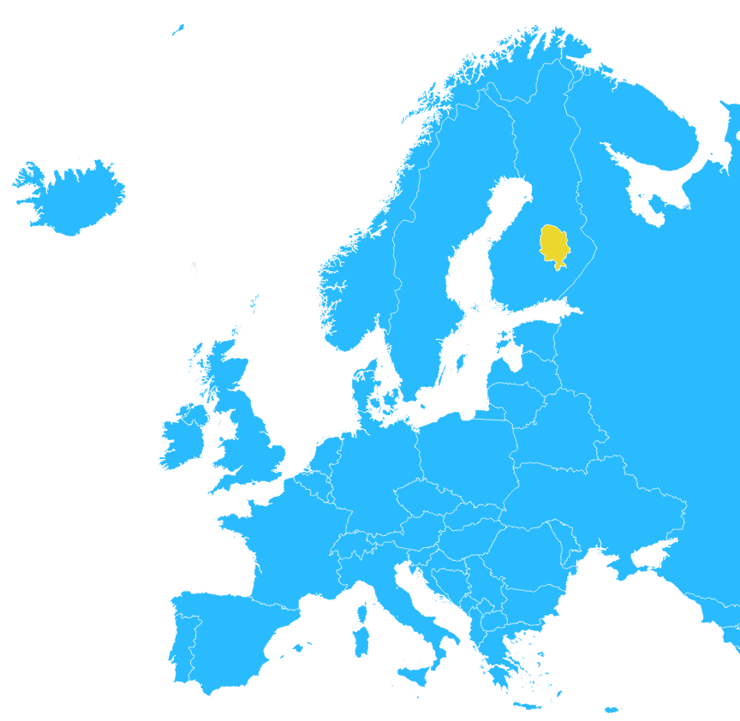
North Savo in a nutshell
Total area (2024): 21 078 km²
Of which waters 18 %
Population (2023): 248 190 (4.4 % of Finland)
Gross Domestic Product (GDP)
Total ( EUR millions) 2021 9 535 (3.8 % of Finland)
Per capita (Finland=100) 2021 85
Per capita (EU27=100) 2021 117
Largest Industries (2023) (EUR millions) % of Finland
Metal and metal products 1 915 2.3 %
Wood and paper 1 043 3.0 %
Food and beverages 747 5.4 %
Companies (2023)
16 759: Combined turnover EUR 15,2 billion
Export EUR 2,7 billion
North Savo Regional Council
Sources: Statistics Finland, Natural Resources Institute Finland (Luke), National Land Survey of Finland

Slide 3
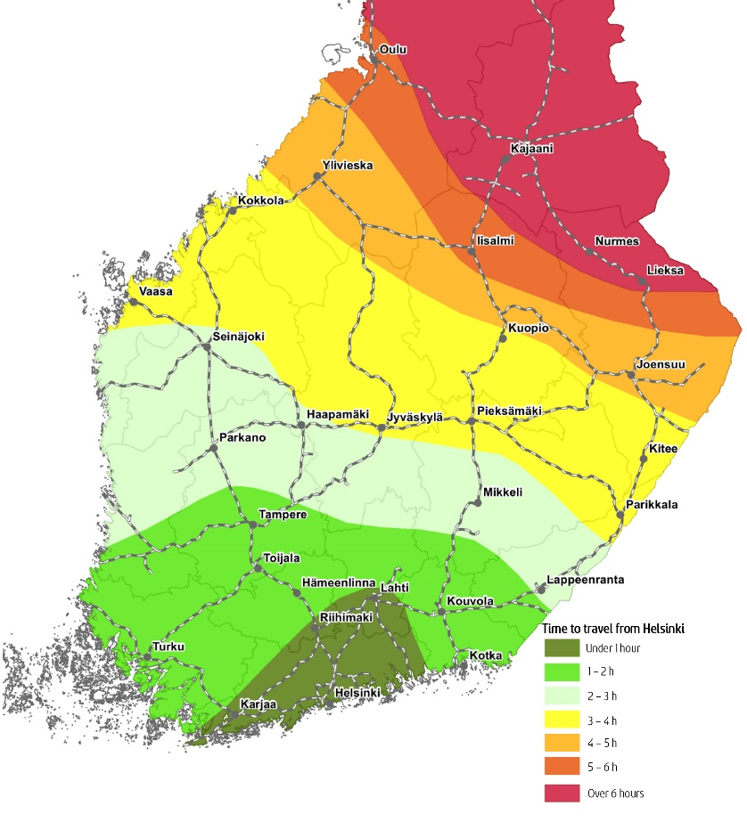
The regional profile of North Savo (as percentage of Finland)
TIME DISTANCES BY TRAIN FROM HELSINKI
North Savo Regional Council
Sources: Statistics Finland, Natural Resources Institute Finland (Luke), National Land Survey of Finland

Slide 4
Smart specialisation in North Savo region
VISIONS OF SPEARHEADS AND THEMES | ICT & Digital - Utilisation of digital technology, increasing the number of competent people. | Climate, Circular Economy & Sustainable Development - Development of the bioeconomy and circular economy cluster and new production. | Competence & Labour Force - Securing the supply of competent workforce, successful integration of foreigners. | Well-being & Culture - Improving the status of health and well-being. Availability of health and social services in the entire region. | Innovation, Enterprise & Growth - Growth of international business and competence therein. Companies that save the environment. | Accessibility & Regional Structure - Implementation of spearhead projects. Enabling remote work and enterprise. Sustainable regional structure.
Machine technology and energy technology - Smart and productive technology and service, successful energy transition.
Forest industry - Diverse utilisation of wood material, increasing added value, emergence of new products.
Food products -The leading region in sustainable food production.
Well-being technology - Better health care and business through health data and new medicines.
Tourism - Growth in nature travel, event travel and cultural travel. Development collaboration throughout Eastern Finland.
Intelligent water system - Smart and comprehensive management of water and waste water systems. Growth of business activity.
Biorefining - New products and bioprocesses, biogas, recycled fertilisers, animal bedding, chemicals, energy.
North Savo Regional Council

Slide 5
Educational institutions in North Savo
North Savo Regional Council
Universities
University of Eastern Finland, Kuopio Campus
The Kuopio Unit of Uniarts Helsinki’s Sibelius Academy
Universities of Applied Sciences
Savonia University of Applied Sciences
Humak University of Applied Sciences, Kuopio Campus
Emergency Services Academy Finland
Vocational Colleges
Savo Vocational College
Ylä-Savo Vocational College
Ingmanedu Vocational College for Cultural Studies
Kuopio Conservatory
Palvelualan Opisto Vocational College
Pohjois-Savon opisto Vocational College
Portaanpää Christian Institute
Luovi Vocational College
Level of education, % (as percentage of population aged 15+) | North Savo | Finland
Population with educational qualification (aged 15+) | 76 | 75
Population with higher education degrees | 30 | 33
Population with upper secondary qualification | 45 | 40
No post-comprehensive qualification completed after basic education | 24 | 25

Slide 6
Research institutes in North Savo
Atmospheric Research Centre of Eastern Finland
Kuopio
Finnish Food Authority
Kuopio
Finnish Institute for Health and Welfare (THL)
Kuopio
Finnish Institute of Occupational Health (FIOH)
Kuopio
Finnish Medicines Agency (Fimea)
Kuopio
Geological Survey of Finland (GSF)
Kuopio
Kuopio Brain & Mind – Neurocenter Finland in Eastern Finland
Kuopio
Natural Resources Institute Finland (Luke)
Maaninka, Suonenjoki
VTT Technical Research Centre of Finland
Kuopio
North Savo Regional Council

Slide 7
Jobs by industry sector (%) in North Savo (2022)
North Savo Regional Council
Source: Statistics Finland

Slide 8
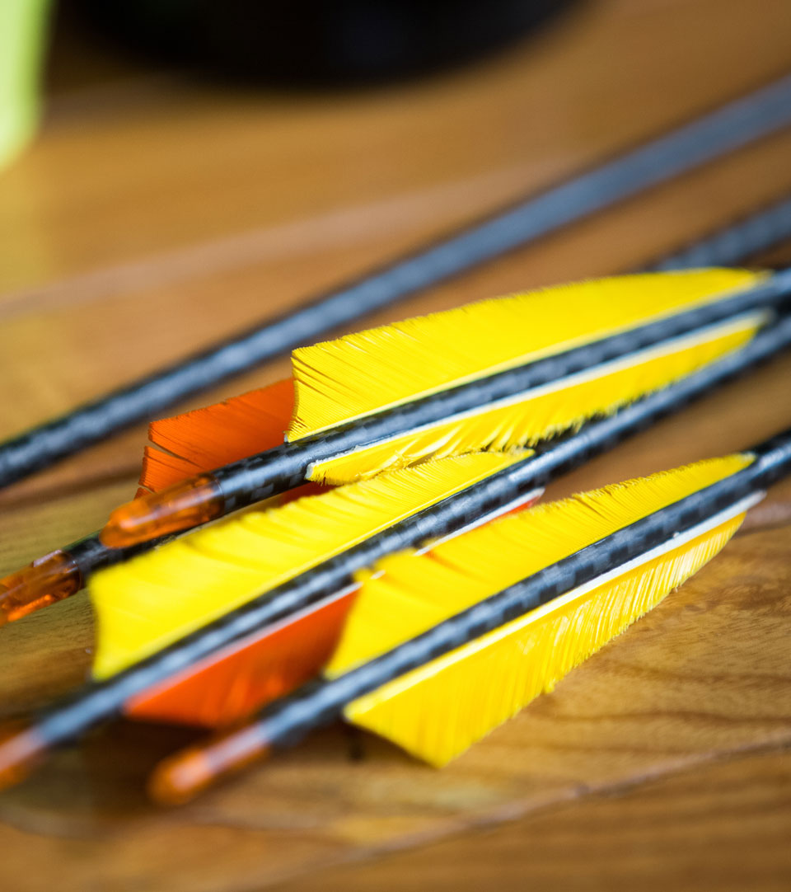
Some important manufacturing companies in North Savo
Ponsse Oyj, Vieremä, Iisalmi | www.ponsse.com
Normet Oy, Iisalmi | www.normet.com
Olvi Oyj, Iisalmi | www.olvi.fi
Profile Vehicles Oy, Iisalmi | www.profilevehicles.com
Valio Oy, Lapinlahti | www.valio.fi
Mondi Powerflute Oy, Kuopio | www.mondigroup.com/en/home/
Honeywell Oy, Varkaus | www.honeywell.com
Bella-Veneet Oy, Kuopio | www.bellaboats.com
Junttan Oy, Kuopio | www.junttan.com
FinVector Oy, Kuopio | www.finvector.com
Charles River DRS Finland Oy, Kuopio | www.criver.com
Yara Suomi Oy, Siilinjärvi | www.yara.com
Hydroline Oy, Siilinjärvi | www.hydroline.fi
Sumitomo SHI FW Energia Oy, Varkaus | www.shi-fw.com
Andritz Oy, Varkaus | www.andritz.com
Stora Enso Oyj, Varkaus | www.storaenso.com
Finland Laminated Timber Oy Ltd, Suonenjoki
Sepa Oy, Keitele | www.sepa.fi
Keitele Forest Oy, Keitele | www.keitelegroup.fi
Oy Lunawood Ltd, Iisalmi | www.lunawood.com
Oy Medfiles Ltd, Kuopio | www.medfiles.eu
Paakkilan Konepaja Oy, Tuusniemi | www.paakkilankonepaja.fi
North Savo Regional Council

Slide 9
Agriculture and horticulture in North Savo (2023)
Number of agricultural and horticultural enterprises 3 014 (7.1 % of Finland)
Cultivated agricultural and horticultural land 153 000 ha (6.8 % of Finland)
Average size of arable land: 51 ha (average 54 ha in Finland)
Berry production in Pohjois-Savo: 26.9 % of the whole country’s production
Milk production in Pohjois-Savo: 14.2 % of the whole country’s production
Beef production in Pohjois-Savo: 13.9 % of the whole country’s production
North Savo Regional Council
Source: Natural Resources Institute Finland (Luke)

Slide 10
Forestry in North Savo
Stumpage earnings (2023)
Finland 3 097 million euros
Pohjois-Savo 331 million euros (10.7 % of Finland)
Total land area 1.7 million hectares of which forest land 1.4 million hectares
Volume of growing stock 206 million m³
Annual growth of stock 9.86 million m³
North Savo Regional Council
Source: Natural Resources Institute Finland (Luke)

Slide 11
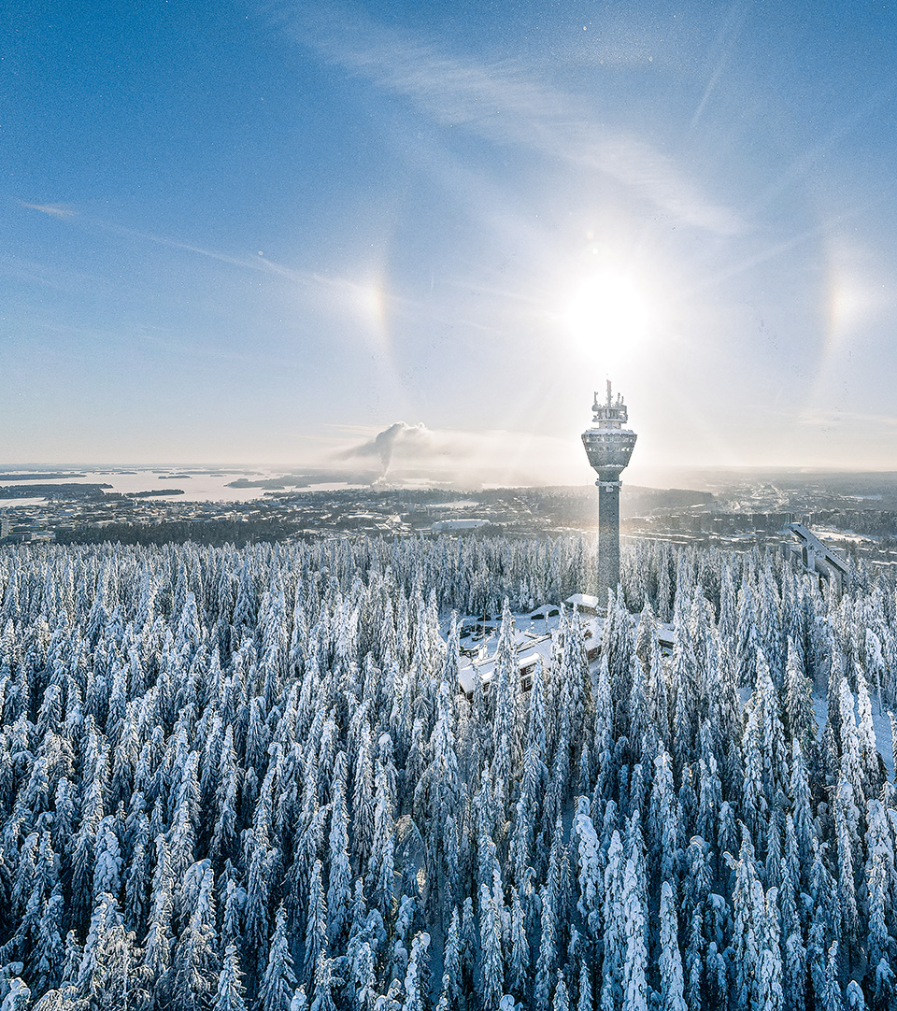
Tourism in North Savo
Sport and free time attractions
Tahko Holiday Resort, Kuopio
Puijo Tower and Puijo Peak Nature Activity Park, Kuopio
Rauhalahti Holiday Centre, Kuopio
Kasurila Ski Centre, Siilinjärvi
Koskisydän Hotel & Nature Resort, Tervo
Metsäkartano Youth Centre and Nature Holiday Resort, Rautavaara
Spas
Spa Hotel Rauhalahti, Kuopio
Spa Fontanella, Siilinjärvi
Spa Hotel Kunnonpaikka, Siilinjärvi
Sport & Spa Hotel Vesileppis, Leppävirta
Tahko Spa, Kuopio
Spa Hotel Runni, Iisalmi
Events
Kuopio Dance Festival, Kuopio
Kuopio Wine Festival, Kuopio
Finland Ice Marathon, Kuopio
Wife Carrying World Championship, Sonkajärvi
Suonenjoki Strawberry Carnival, Suonenjoki
Oluset Beer Festival, Iisalmi
Kuopiorock, Kuopio
Sampea ja sampanjaa Festival, Varkaus
Joroinen Music Festival, Joroinen
North Savo Regional Council

Slide 12
Population, jobs and income tax percentages in North Savo
Municipality | Population in 2023 | Total number of jobs in 2022 | Primary production (%) (as percentage of the total number of jobs) | Industry (%) (as percentage of the total number of jobs) | Services (%) (as percentage of the total number of jobs) | Municipal tax rate (%) in 2024
Iisalmi | 20 618 | 8 931 | 3,5 | 28,0 | 67,6 | 7,90
Joroinen | 4 590 | 1 298 | 25,3 | 21,6 | 51,1 | 8,60
Kaavi | 2 628 | 765 | 12,8 | 24,1 | 61,8 | 9,80
Keitele | 2 035 | 938 | 12,4 | 38,4 | 48,4 | 7,90
Kiuruvesi | 7 475 | 2 280 | 23,5 | 15,0 | 59,6 | 9,50
Kuopio | 124 021 | 55 401 | 2,4 | 15,1 | 81,5 | 8,10
Lapinlahti | 8 975 | 2 763 | 16,5 | 25,6 | 56,5 | 9,40
Leppävirta | 9 049 | 2 863 | 6,7 | 40,7 | 51,6 | 8,40
Pielavesi | 4 073 | 1 146 | 22,8 | 10,3 | 64,8 | 9,10
Rautalampi | 2 933 | 829 | 17,9 | 15,9 | 64,1 | 9,90
Rautavaara | 1 424 | 426 | 11,7 | 12,2 | 75,6 | 9,40
Siilinjärvi | 21 290 | 7 227 | 3,6 | 30,4 | 64,9 | 9,40
Sonkajärvi | 3 637 | 1 084 | 20,1 | 15,4 | 63,0 | 8,60
Suonenjoki | 6 708 | 2 360 | 7,2 | 28,7 | 62,8 | 9,10
Tervo | 1 412 | 347 | 18,4 | 6,3 | 74,1 | 9,90
Tuusniemi | 2 313 | 621 | 21,6 | 19,0 | 57,3 | 9,40
Varkaus | 19 727 | 8 035 | 1,7 | 34,3 | 63,4 | 8,80
Vesanto | 1 895 | 504 | 20,2 | 5,8 | 71,8 | 9,20
Vieremä | 3 387 | 2 018 | 16,7 | 55,9 | 26,6 | 8,40
Pohjois-Savo | 248 190 | 99 836 | 5,3 | 21,3 | 72,4 | 8,46
Koko maa | 5 603 851 | 2 423 548 | 2,5 | 21,0 | 75,3 | *7,46
North Savo Regional Council
Sources: Statistics Finland, Association of Finnish Municipalities. *The average municipal tax rate in mainland Finland.

Slide 13
Pohjois-Savon liitto North-Savo Regional Council
Sepänkatu 1
FI-70100 Kuopio
Finland
Tel: +358 17 550 1400
www.pohjois-savo.fi/en
North Savo Regional Council

